Slide 1
Arguments
Debate 101

Slide 2
Overview
Part 1: Ethos, Pathos, Logos
Part 2: Arguments: standard, Toulmin, Sexi
Part 3: Practice
András Meleg
07/08/2021

Slide 3
Part 0: Why do we debate?
Disclaimer: not to convince people ☹

Slide 4
Why do we debate?

Slide 5
In Debateland we have a motto:
Cogito
ergo sum

Slide 6
Personal interacting skills
English
Public speaking
Skill to listen

Slide 7
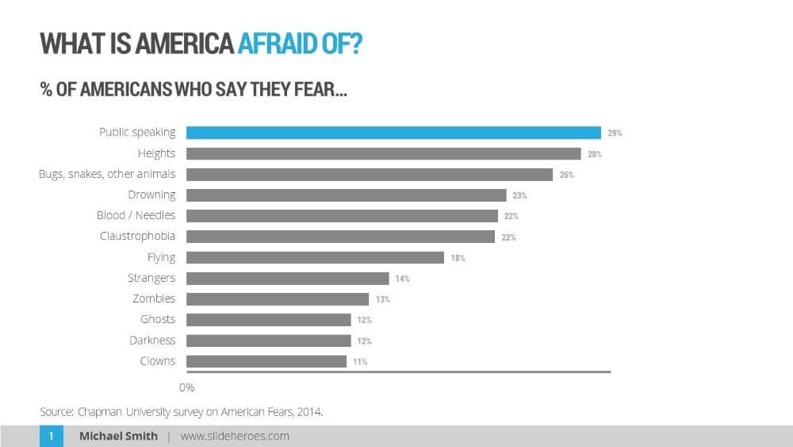
Personal interacting skills
English
Public speaking
Skill to listen

Slide 8

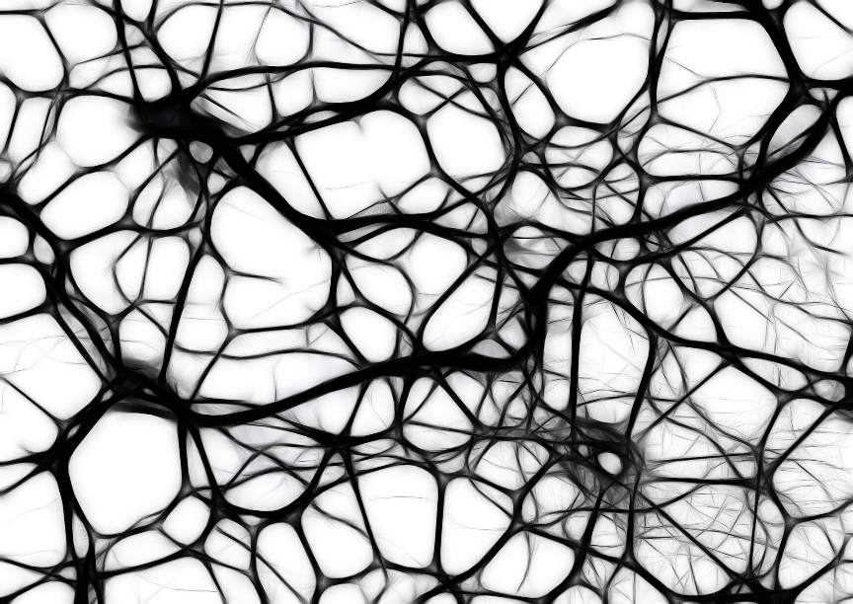
The „think-tank” skills
Critical analysis
Refutation
Refutation
Questioning
Questioning

Slide 9
Part 1:
Ethos – pathos - logos

Slide 10
Ethos-pathos-logos
Ethos
Logos
Pathos

Slide 11
Ethos-pathos-logos
Ethos
  Speaker’s credibility, personality – WHO?
Ethos
Pathos
  Connection with the audience –
  HOW?
Logos
Pathos
Logos
  Logical argumentation – WHAT?

Slide 12
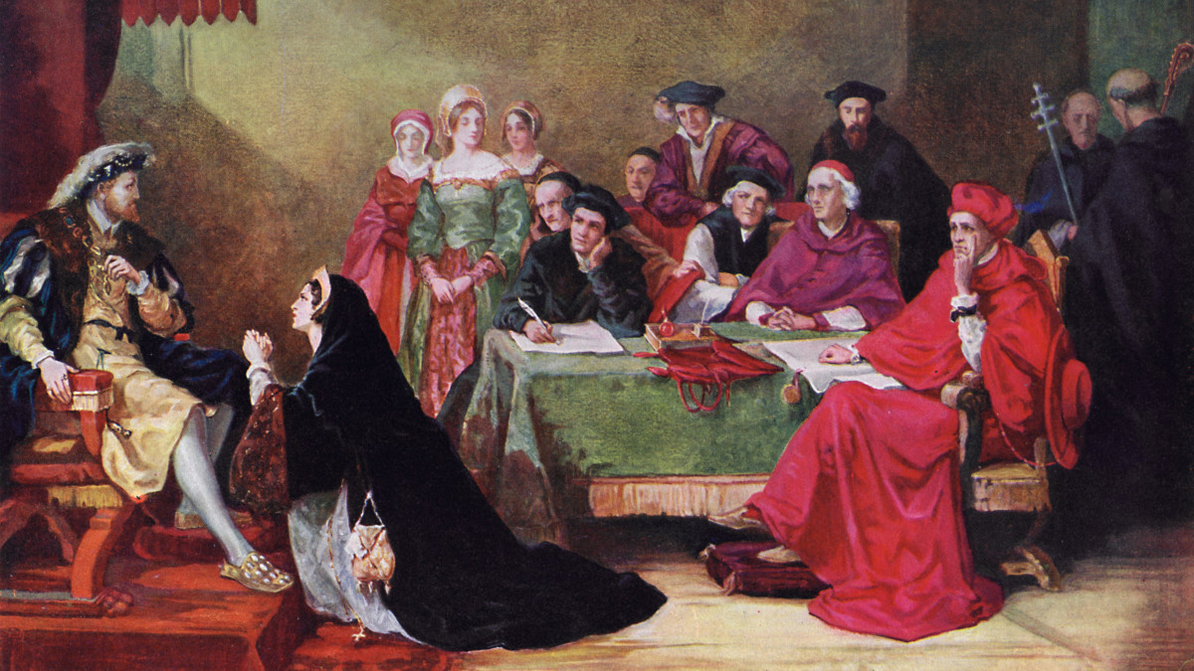
Story about pathos

Slide 13
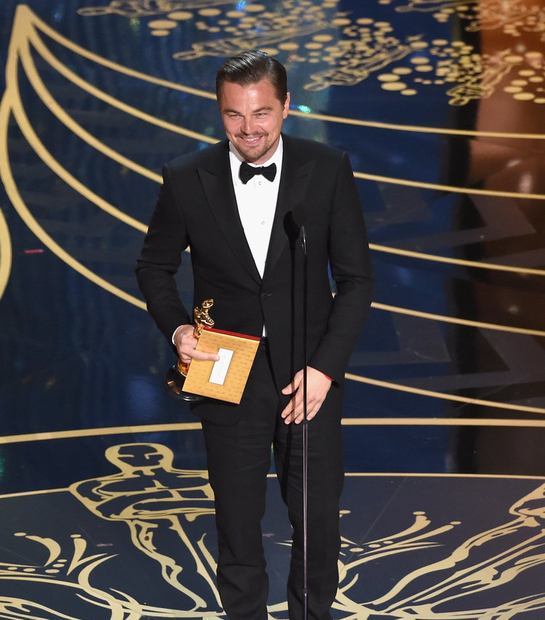
Story about ethos

Slide 14
Ethos-pathos-logos
Ethos
  Speaker’s credibility, personality – WHO?
Ethos
Pathos
  Connection with the audience –
  HOW?
Logos
Pathos
Logos
  Logical argumentation – WHAT?

Slide 15

Ethos = morals, personality
„I am the state...”
„Trust me! I will protect you...”
Ethos in not always part of the speech – many times its hard to recognise.
Yet its an integral part of the way we think.
We read from left to right: therefore the second is on the left side of the podium.
„Influencer” marketing is all about ethos

Slide 16
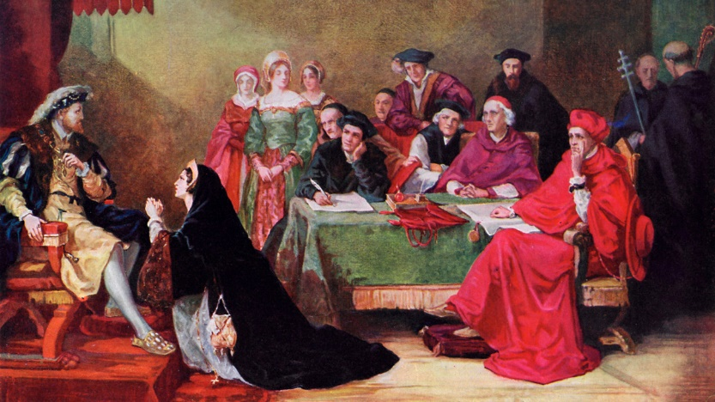
Pathos = passion
Expressing feelings is part of pathos.
The slides of the presentation are the part of pathos.
(How many slides do you need for a presentation, and when do you have too much information on a slide?)
The stylistic elements during your speech are a part of pathos.
Aristotle → rethorics =/= stylistic spech, but also the ethical and logical speech
Humour is part of pathos

Slide 17
How to improve ourselves?
Standard methods
  Debate Club, repetition, etc.
Always make notes! Literally!
  Never write down speech word by word! Aristotle ←→ 21th century
Get to know our weaknesses
  What are our pronunciation mistakes? How is our rhetorics? When do we sound confident? How does our dody-language work?? → ask our friends! !
  Everyone will like something else! ☺

Slide 18
What is an argument?
What is the purpose of the argument?
What is important in the argument?
What makes an argument „strong?”

Slide 19
The Toulmin-model
Statement
conclusion what you want to prove
Warrant / Proof facts, independently proven data, generally accepted things
Reasoning
the link, that connects statement & proof
provides relevance for the proof
CLAIM
REASONING
PROOF

Slide 20
The Sexi modell
Statement
Explanation
Impact

Slide 21
The Sexi modell
What will happen?
How will it happen?
„So what?” Why is it relevant?
Statement
Explanation
Impact

Slide 22
This House Believes That:
„a benevolent dictator is
better than a weak democracy!”

Slide 23
THO the narrative that love (romantic, familial, etc.) is about sacrifice
CLAIM
REASONING
PROOF

Slide 24
TH prefers to live an average anonymous life over being a superstar
CLAIM
REASONING
PROOF

Slide 25
Practice / Break (2x3 minutes)
1) This House Supports common European border control !
2) This House Would ban gun ownership in the US !
3) This House Believes That Artists should not participate in the ongoing interpretation of their art.
4) This House Supports a high minimum wage

Slide 26
II: Why is it important?
Impact:
how important is what I say?
Opposition
Mechanism:
how true is what I say?
Government

Slide 27
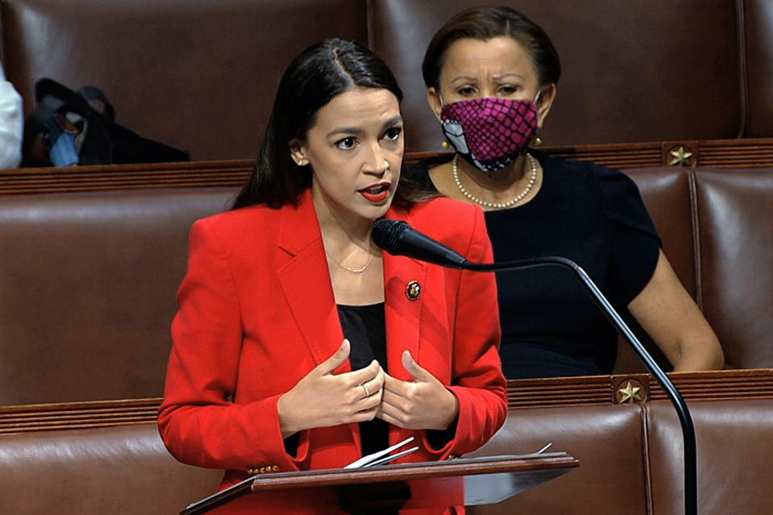
II: Why is it important?
Impact:
how important is what I say?
Opposition
A3
A1
A2
Mechanism:
how true is what I say?
Government

Slide 28

II: Why is it important?
Impact:
how important is what I say?
Opposition
Refutation bulldozer
A1
A3
Mechanism:
how true is what I say?
A2
Government

Slide 29
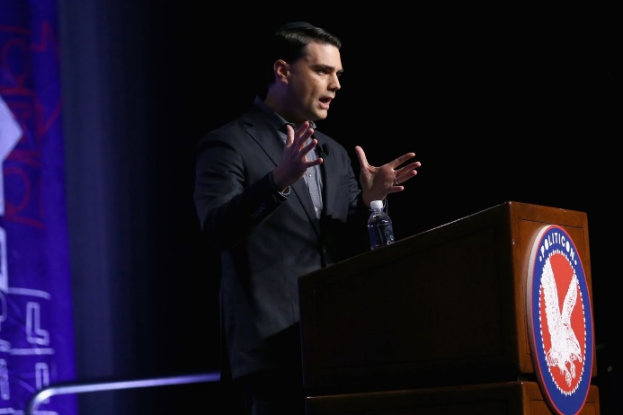
II: Why is it important?
Impact:
how important is what I say?
Opposition
B3
B2
B1
A1
A3
Mechanism:
how true is what I say?
A2
Government

Slide 30
II: Why is it important?
Impact:
how important is what I say?
Opposition
B3
B2
B1
Refutation bulldozer
A1
A3
A1
Mechanism:
how true is what I say?
A2
A2
Government

Slide 31
II: End of the debate
Impact:
how important is what I say?
Opposition
B2
B1
B3
A3
A1
Mechanism:
how true is what I say?
A2
Government

Slide 32
II: End of the debate
How important?
B2
A3
B1
A1
B3
A2
How true?

Slide 33
Let’s try again!
1) This House Supports common European border control!
2) This House Would ban gun ownership in the US !
3) This House Believes That Artists should not participate in the ongoing interpretation of their art.
4) This House Supports a high minimum wage

Slide 34
Team 1
Team 2
Team 3
Team 4

Slide 35
Team 1
Team 2
Team 3
Team 4

Slide 36
7 minute speeches

Slide 37
7 minute speeches
Prop1 - Opp1
Prop2 - Opp2

Slide 38
7 minute speeches
Prop1 - Opp1
Prop2 - Opp2

Slide 39
7 minute speeches
Prop1 - Opp1
Prop2 - Opp2

Slide 40
7 minute speeches
Prop1 - Opp1
Prop2 - Opp2
After the 2 opening teams comes the 2 closing teams

Slide 41
7 minute speeches
Prop1 - Opp1
Prop2 - Opp2
After the 2 opening teams comes the 2 closing teams
The closing teams have more time to prepare and think

Slide 42
BUT they have to approach the debate from a different angle
7 minute speeches
Prop1 - Opp1
Prop2 - Opp2
After the 2 opening teams comes the 2 closing teams
The closing teams have more time to prepare and think

Slide 43
BUT they have to approach the debate from a different angle
7 minute speeches
And the last speakers shouldn’t introduce new arguments!

Slide 44
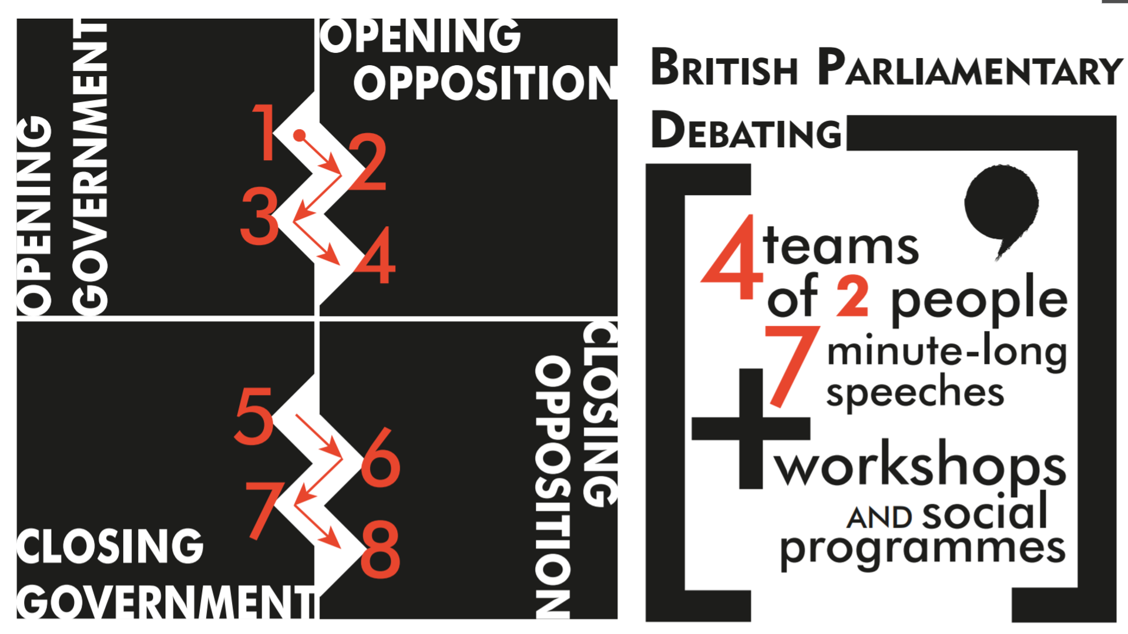

Slide 45
Thank you for your attention!

Slide 46
Questions?
Why this Debate Format?

Slide 47
andras.meleg@stud.uni-corvinus.hu

